Slide 1
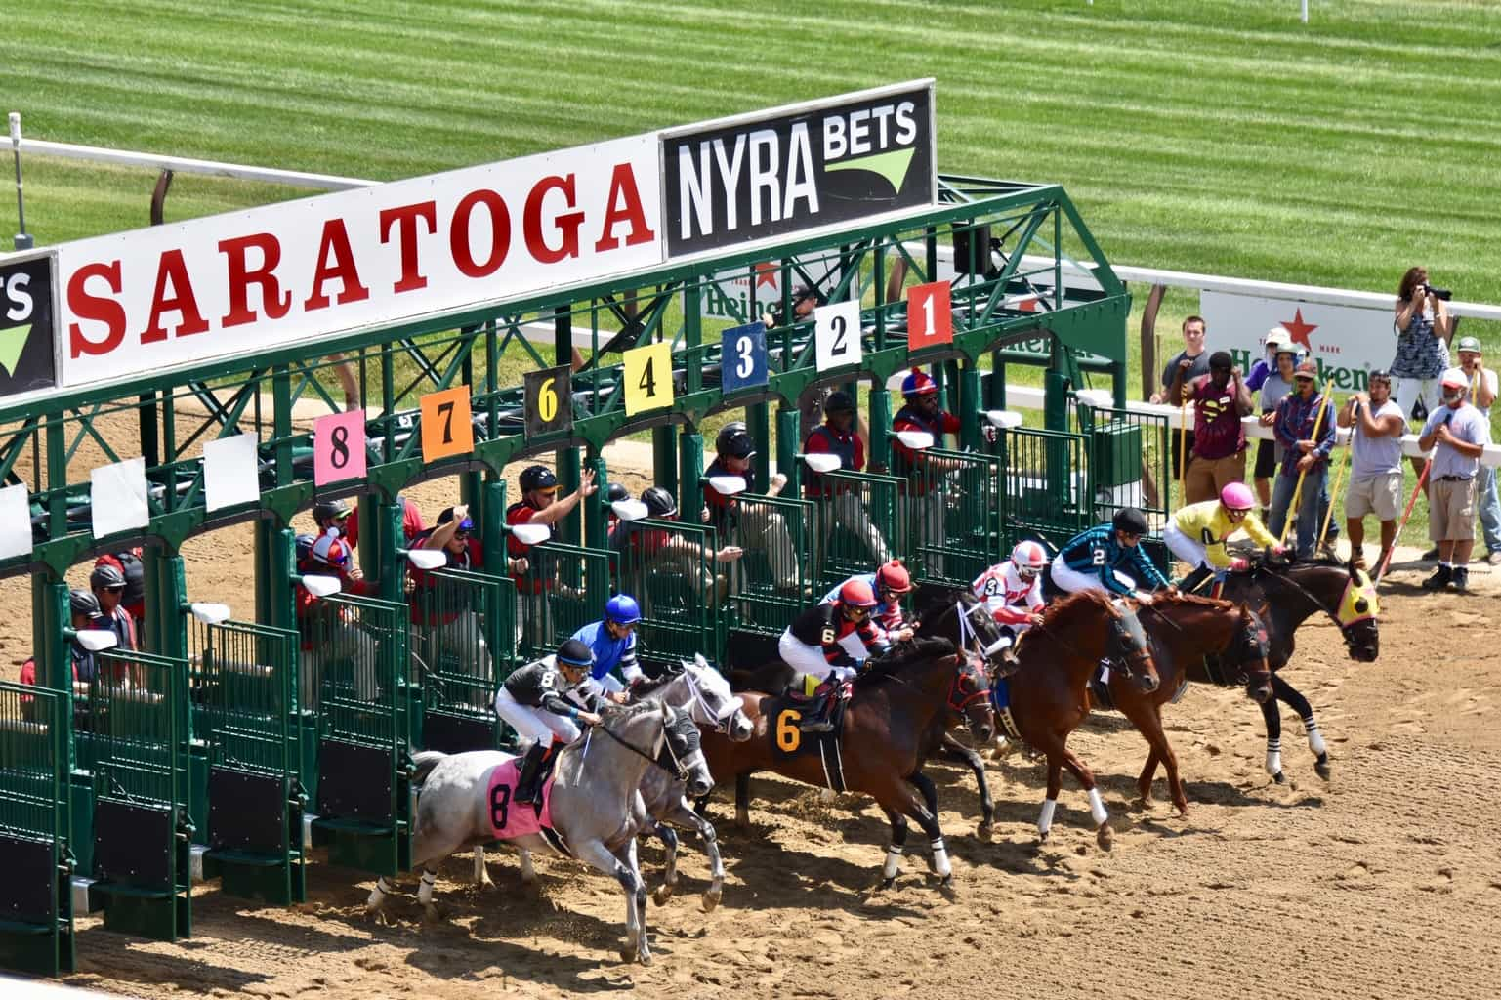
Horse Racing Data Analysis
• 22.10.2022
Team Leo!
Ishita PES1UG20CS648, Hita PES1UG20CS645

Slide 2
Line Up
An Introduction
EDA
Clustering
Modelling
Results
Next Up

Slide 3
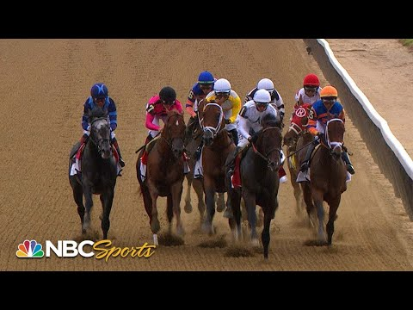
Ever seen a horse race?
Have a look now ⬅️
https://www.youtube.com/watch?v=wIYD42DV3Ro&

Slide 4
Introduction
America’s most prestigious and oldest horse races are held annually at Aqueduct, Belmont, Saratoga.
Each horse is tracked every 0.25 seconds using trakus index (real-time tracking system that determines the exact geographical location of the horse.
Some nuggets 🍗
1. Purse
2. Drafting Strategy
3. Maiden Races
4. Stakes
5. Allowance Races
6. Claiming Races
7. Odds
8. Jockey
9. Race Course Types - Hurdle Surfaces, Turf and Dirt
10. Track Conditions - Muddy, Sloppy, Firm, Yielding

Slide 5
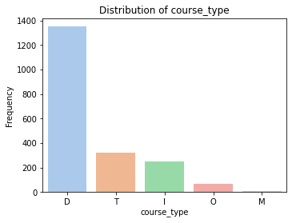
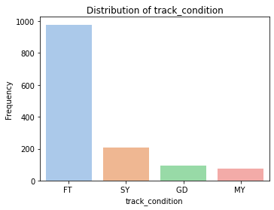
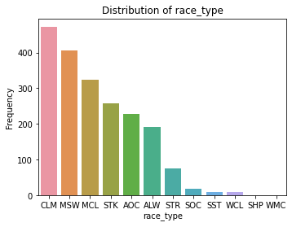
EDA
D - Dirt
T - Turf
I - Inner Turf
O - Outer Turf
FT - Fast Track
SY - Sloppy
M - Muddy
GD - Good
CLM - Claiming
MSW - Maiden Special Weight
STK - Stakes

Slide 6
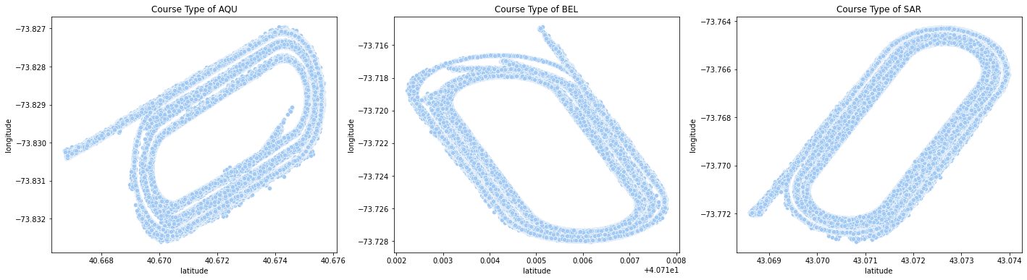
Scatterplots of the racing track at the 3 locations, Aqueduct(AQU), Belmont(BEL) and Saratoga(SAR)

Slide 7
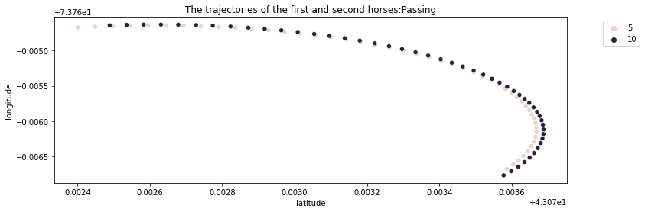
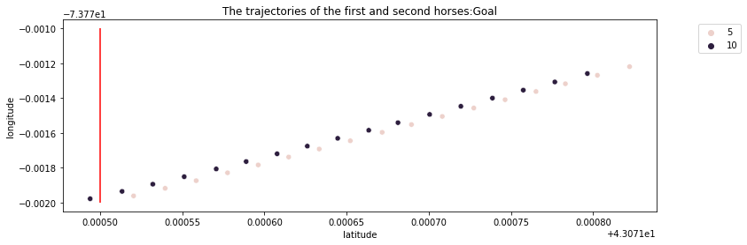
Scatterplot of the trajectory followed by the winner and runner-up horse at the finish line.
Close up of the first horse overtaking the second.

Slide 8
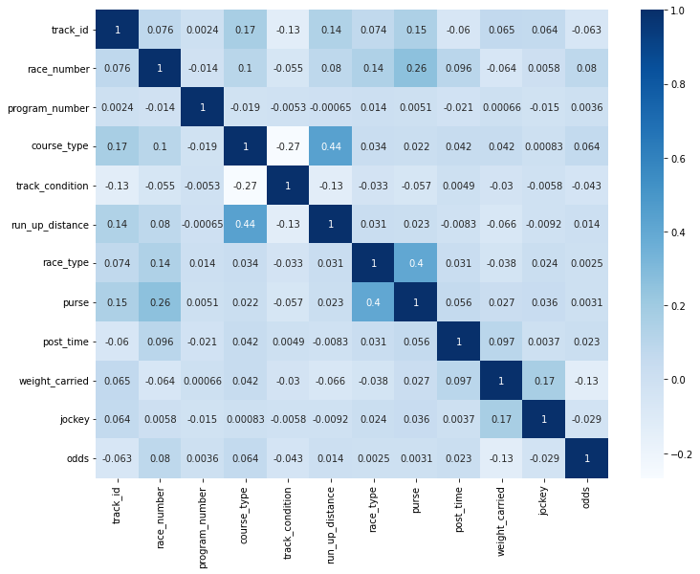
Correlation heat map of chosen relevant attributes.
Attributes that show high degree of coreelation:
course_type and run_up_distance = 0.43
purse and race_type = 0.42

Slide 9
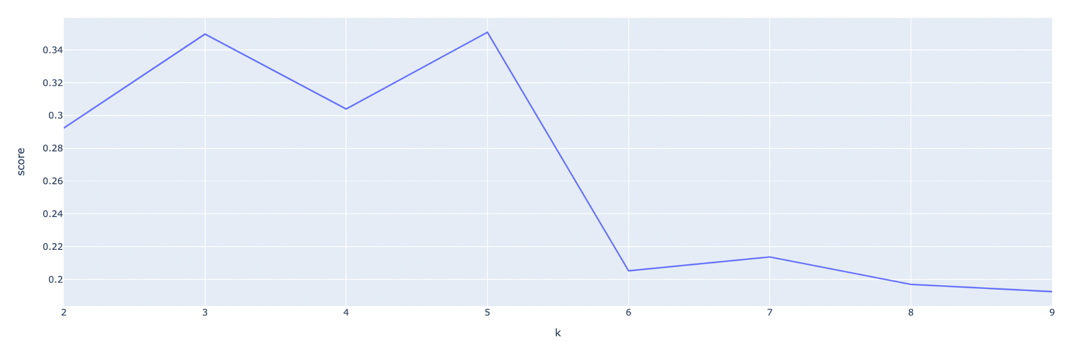
Unsupervised Learning - Clustering
The aim is to find any patterns/understand the racing data more.
K means clustering followed by agglomerative clustering(hierarchical clustering) is implemented.
Elbow plot for K means Clustering.
Optimum value, K=6
The graph is a oscillating a bit until 5 clusters.

Slide 10
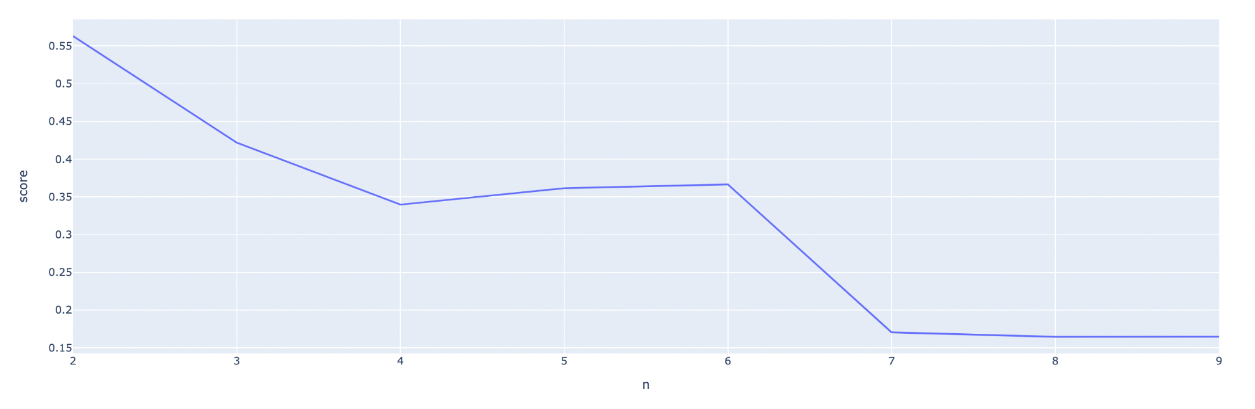
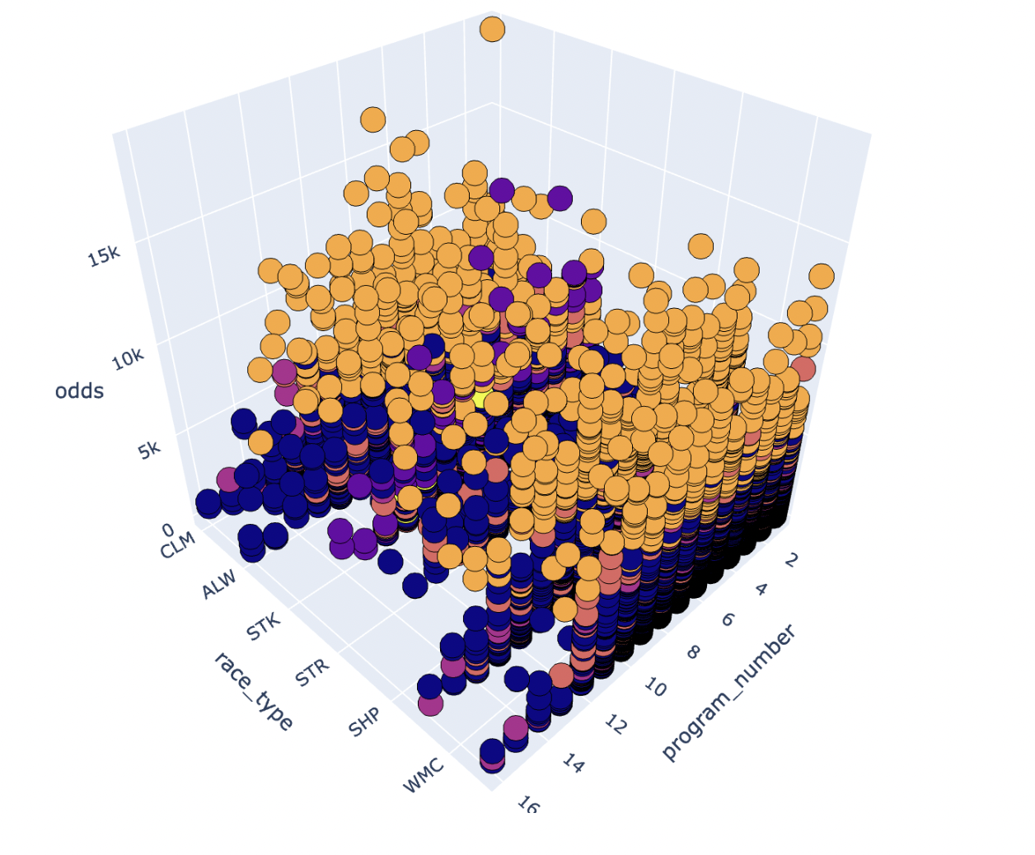
Elbow plot for Agglomerative Clustering.
Optimum value, K=6.
We proceed with this as it has an appropriate knee shape.
3D Overview of clusters formed of data points.
(with respect to race_type and program_number(unique identifier of a horse))

Slide 11
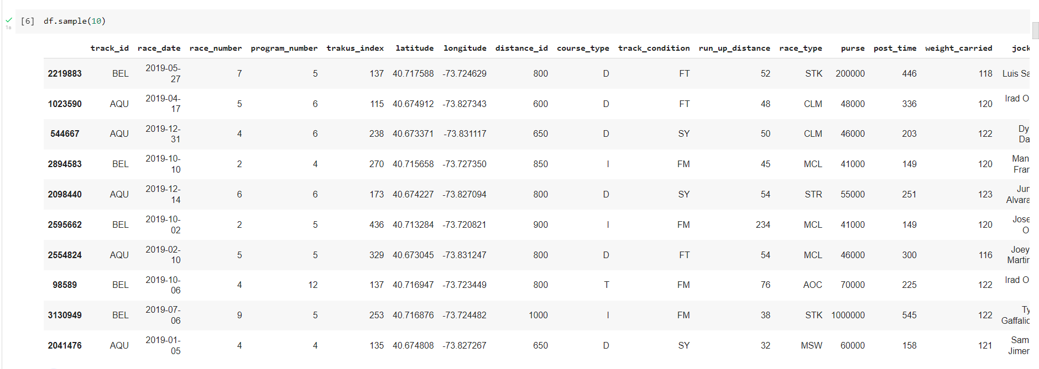
Preprocessing
Before Preprocessing

Slide 12
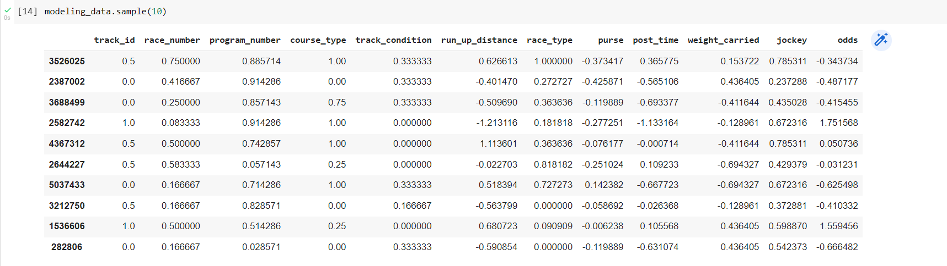
Preprocessing
After Preprocessing -
Removed unnecessary columns such as race_id, trackus_index, latitude, longitude, distance_id and duplicate rows. Performed data scaling and standardisation - MinMaxScaler for categorical data and StandardScaler for continuous data.

Slide 13
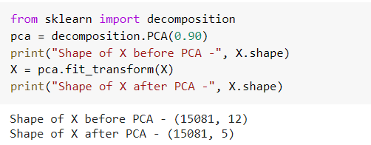
PCA
Performed PCA on the modeling_dataset -
Principal component analysis, or PCA, is a dimensionality-reduction method that is often used to reduce the dimensionality of large data sets, by transforming a large set of variables into a smaller one that still contains most of the information in the large set.
Smaller data sets are easier to explore and visualize and make analyzing data much easier and faster for machine learning algorithms without extraneous variables to process.

Slide 14
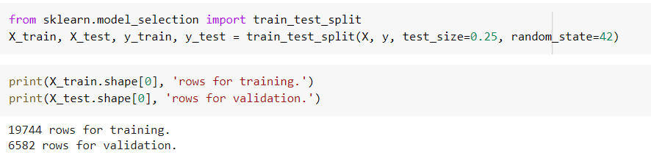
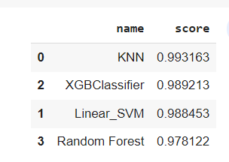
Modeling and Inference
Split the modeling dataset into training (19744 rows) and test(6582 rows)
Trained models such as KNN, XGBClassifier, Linear_SVM and Random Forest on the training dataset. RandomForestClassifier, etc. computes the accuracy of the model on the testing data (accuracy is #correct_preds / #all_preds) after being trained on the training data. From this table, it is evident that all performed well and KNN performed best amongst the given models.

Slide 15
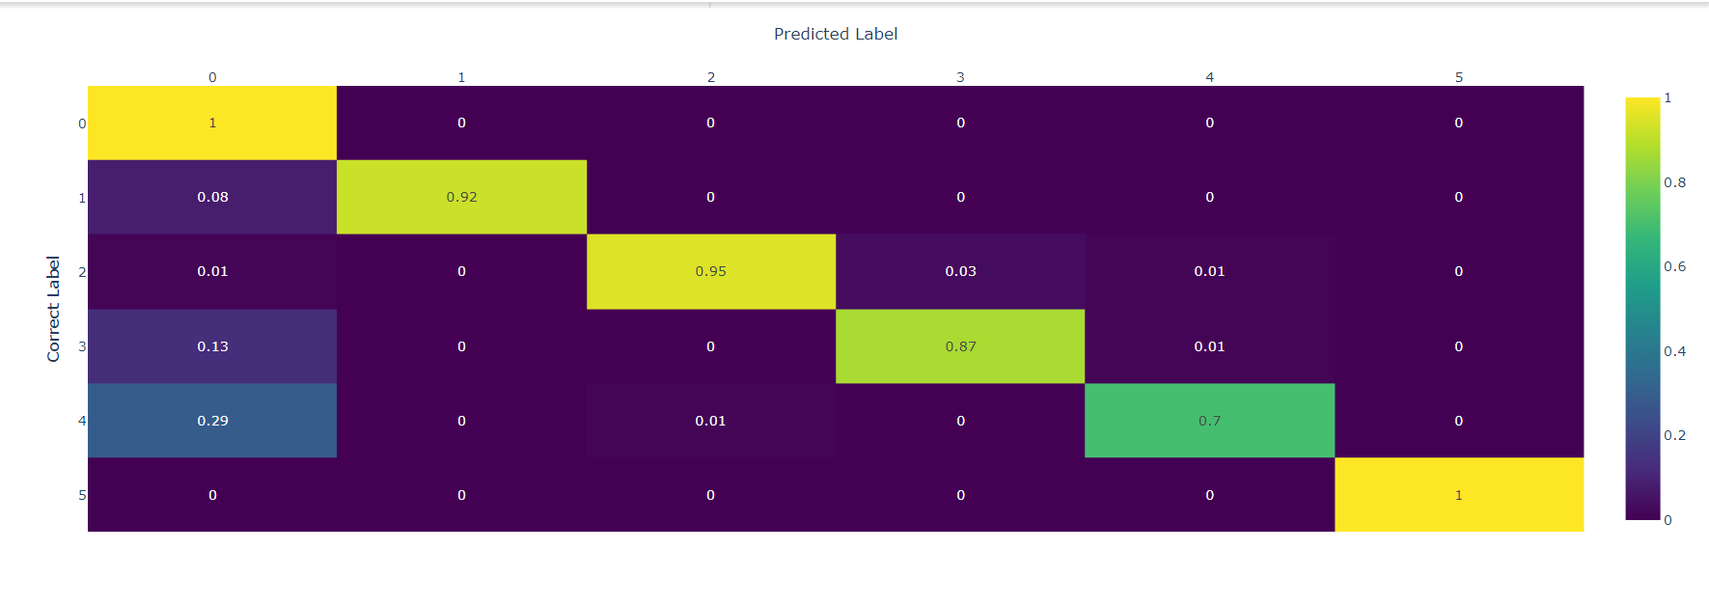
Confusion Matrix
Given below is the confusion matrix between the actual and predicted odds by our classifier.

Slide 16
Preprocessing
(label encoding, scaling, feature selection,dimensionality reduction train-test split)
EDA
Inference
1
2
3
4
5
Unsupervised Learning(k means & agglomerative clustering)
PCA and Modelling

Slide 17
Next Steps
Analysis Of Models
Conclusion

Slide 18
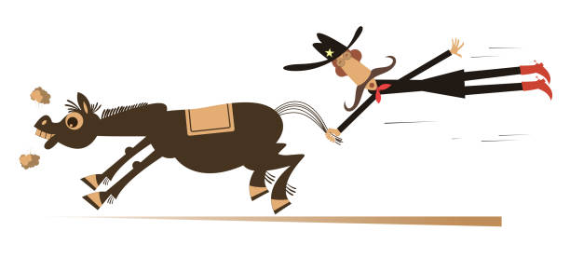
Thank You!

